Slide 1
Review! 9.1 & 9.2
Local governments are established by?
What is a charter?
What is a municipality?
Local governments make what kind of laws? States? Federal?
Which district are we in? Who is our commissioner?
What does At-large mean?
What are some services the county commission provides?
Who is our mayor? What are his/her roles?

Slide 2
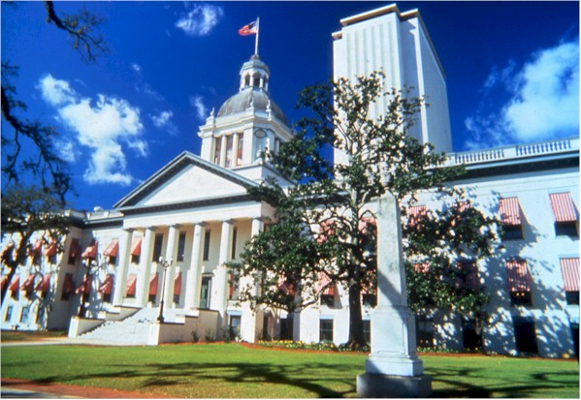
9.3 City Government

Slide 3
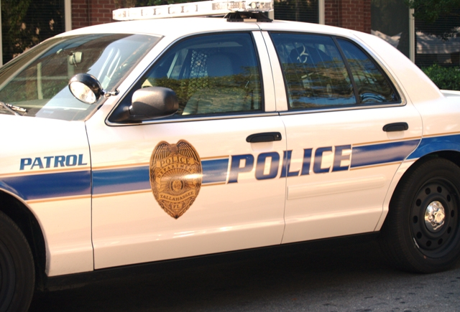
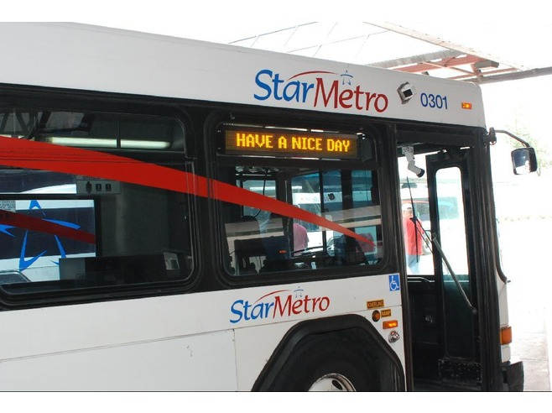
Forms of City Government
Local governments (city/county) provide a variety of services such as education, transportation systems, sanitation, fire and police protection, etc.

Slide 4
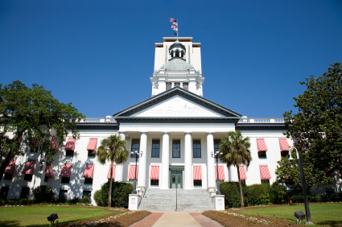
Forms of City Government
Most city governments are organized in one of 3 ways:
1. Mayor-council Government
2. Commission Government
3. Council-manager Government

Slide 5
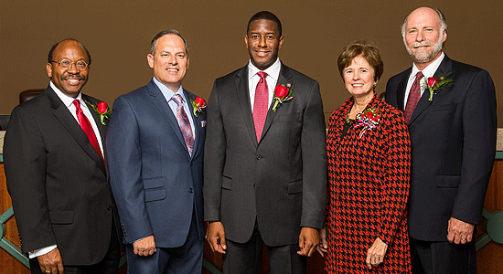
Mayor-Council Government
Mayor-council government is the oldest and most common form of city government in America.
The city council is the legislative body and the mayor is the city’s chief executive officer.
There are two types of mayor-council gov’t:
Weak-Mayor
Strong-Mayor

Slide 6
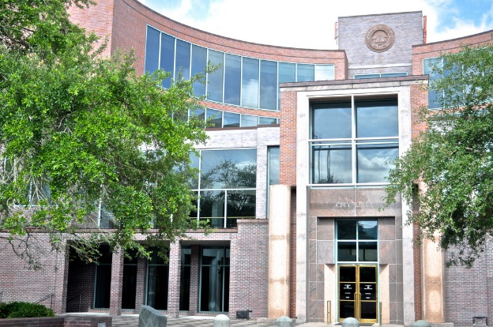
Weak-Mayor Government
Under the weak-mayor form of government, the mayor is the city’s chief executive officer and co-equal member of the city council/commission.
Generally speaking, the council holds more power than the mayor does individually.
The mayor acts as of “Head of City”

Slide 7
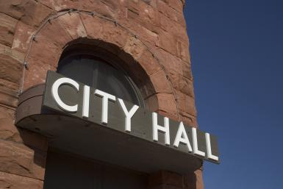
Strong-Mayor Government
Under the strong-mayor government, the mayor is the city’s chief executive officer and most powerful member of a city council/commission.
The mayor’s primary responsibility is to run the city government and appoint most of the city officials and prepare city budgets.

Slide 8
Commission Government
Another form of city government is called a commission government.
The commission acts as the city’s executive body (instead of a mayor) and each commissioner heads a city department
Some departments they oversee include:
Public safety
Public works
City’s finances
Public welfare

Slide 9
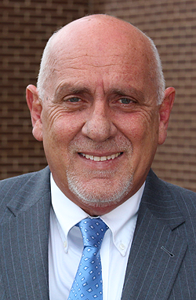
Council-Manager Plan
Under the council-manager plan voters elect a city council to act as the city’s law making body and the council appoints a city manager as the city’s chief executive.
Pro: The city managers are appointed (free from any political pressure) and they can be fired by the council if they don’t do their job correctly.
Con: Some cities can’t afford to hire a good manager and they argue that all city officials should be directly accountable to the voters.

Slide 10
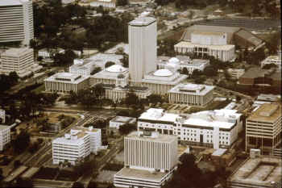
Forms of City Government
In Tallahassee, we have a council/manager form of local government.
We also have a Mayor who works cooperatively with our city commission to appoint a city manager.

Slide 11
9.4 How Governments Work Together

Slide 12
Governments Work Together
Under the U.S. federal system of government, the powers of each level of government are clearly defined.
Local
State
Federal

Slide 13
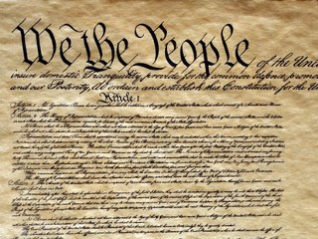
Governments Work Together
The U.S. Constitution is the “Supreme Law of the Land”. This is stated in Article 6 of the Constitution.
This means that state and local governments cannot violate the US Constitution.

Slide 14
Governments Work Together
Many issues require cooperation among local, state and federal governments.
For example, the nation’s roads and highway system
In colonial days, building roads was a local project.

Slide 15
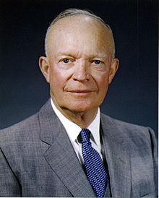
Governments Work Together
President Dwight D. Eisenhower was instrumental in the construction of the nation’s interstate highway system
In 1965, Eisenhower signed legislation that funded the creation of the U.S. interstate highway system

Slide 16
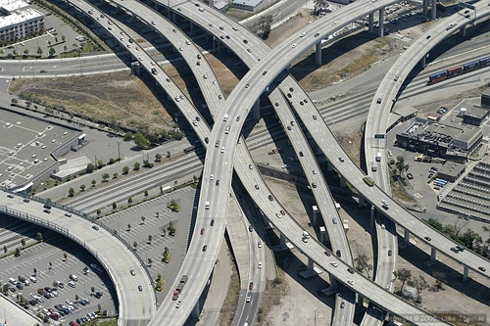
Governments Work Together
Today more than 46,000 miles of interstate highways connect almost all parts of the country (The Federal Government pays 90% of the cost, the state and local government pay the last 10%)

Slide 17
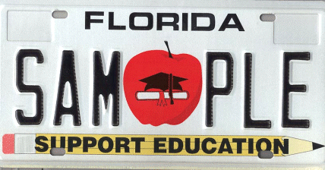
Governments Cooperate to Serve the Public
Public education is one of the most important areas in which governments cooperate to serve the public:
Federal government: implements national accountability goals/incentives
State governments: grant funds
State boards of education: provide for local school districts
Local school boards: actual control of the schools

Slide 18
Governments Cooperate to Serve the Public
Grants-in-aid are federal funds given to state and local governments for specific projects like airport construction or pollution control.

Slide 19
Governments Cooperate to Serve the Public
States work with local government to ensure that all industries obey all safety regulations.
State governments establish state licensing boards to ensure the community has qualified professional workers. (Teachers, nurses, hair dressers etc.)

Slide 20
Citizenship in the Community
At the end of the day, we are all members of communities. Communities can come in many different forms – small to large… (home, neighborhood, school….city, county, state, etc.)
Communities Provide:
Ways to address issues and communicate
Services that make life easier and healthier
Services that are necessary for life
Opportunities to work, raise a family, and contribute to society
Protection, safety, peace and order
Culture, meaning (“belonging”), and education
Recreational facilities to encourage health, diversion, cultural learning, and relaxation.
NEXT

Slide 21
Review 9.3 & 9.4
Under the council-manager plan, how does the city manager become the chief executive?
What kind of form of government does the city of Tallahassee have?
Which President was instrumental in the creation of the Nation’s interstate highway system?
Federal funds given to the state and local governments for specific projects, are called what?
Why does the state government establish state licensing boards?
What are the three types of city governments?
In the Mayor-Council government, what is the city’s legislative body and who is the city executive officer?

